Slide 1
Student Management System
Presented by……
V. Supriya

Slide 2
Introduction:
A front-end web application for managing admissions, attendance, marks, and fee records — built with HTML, CSS, and JavaScript.

Slide 3
Project Aim:
To design and develop a simple, browser-based Student Management System that allows a registrar or administrator to record and view student admissions, attendance, marks, and fee details from a single, easy-to-use dashboard — without relying on paper registers or scattered spreadsheets.

Slide 4
ABSTRACT
The Student Management System is a simple front-end web application developed using HTML, CSS, and JavaScript. It is used to manage student admissions, attendance, marks, and fee records. The system provides an easy-to-use interface for adding, viewing, and updating student information. It helps organize records, reduces manual work, and saves time.

Slide 5
System Overview:
The Student Management System is a simple front-end web application developed using HTML, CSS, and JavaScript.
Core Modules
Admission Module – Add and manage student admission details.
Attendance Module – Record and view student attendance.
Marks Module – Add and manage student marks.
Fee Module – Record and track student fee details.

Slide 6
Advantages:
Easy to use.
Saves time.
Reduces manual work.
Stores student records in one place.
Simple and user-friendly interface.
Easy to update student information.

Slide 7
Disadvantages
No database support.
Limited features.
No login system.
Data is not stored permanently.
Suitable only for small projects.

Slide 8
Future Scope
Add a database to store data permanently.
Implement a user login system.
Generate reports automatically.
Add student and teacher dashboards.
Make the system accessible on mobile devices.

Slide 9
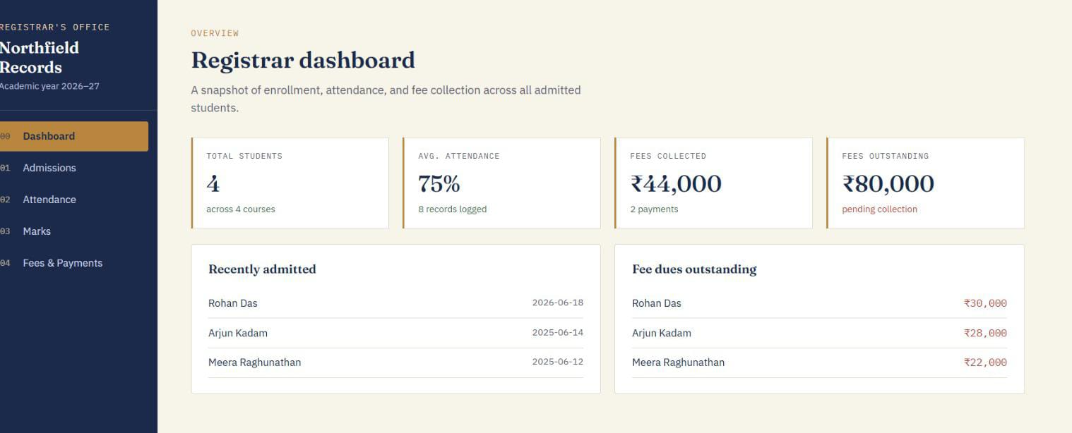
Outputs:
1.Dashboard:

Slide 10
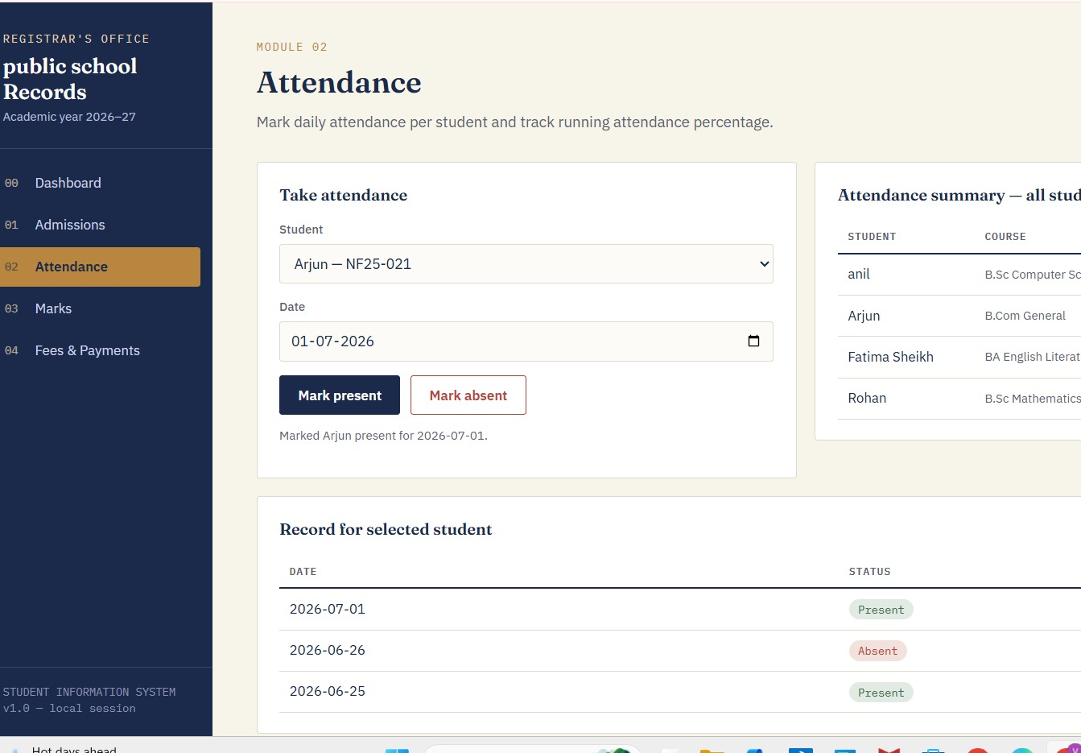
2.Admissions:

Slide 11
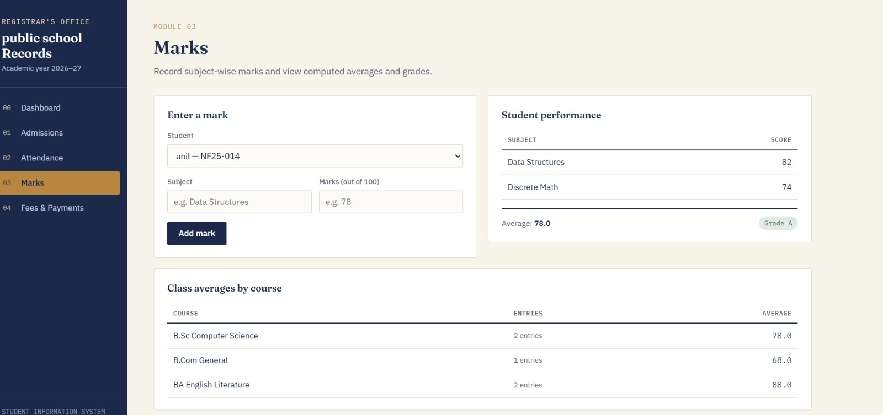
3.Marks:

Slide 12
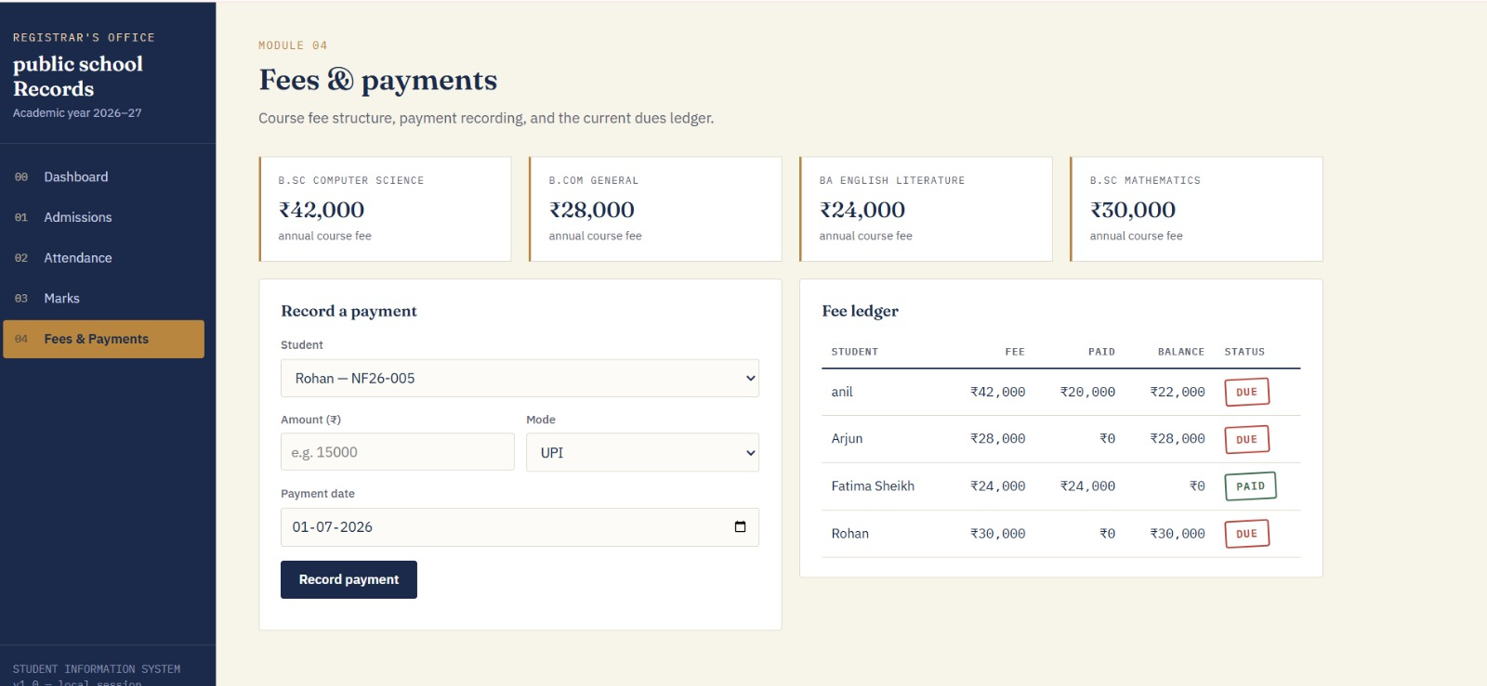
4.Fees&payments:

Slide 13
Conclusion:
The Student Management System is a simple and user-friendly web application developed using HTML, CSS, and JavaScript. It helps manage student admissions, attendance, marks, and fee records efficiently. The system reduces manual work, saves time, and makes student data easy to organize and manage.

Slide 14
THANK YOU!

